Slide 1
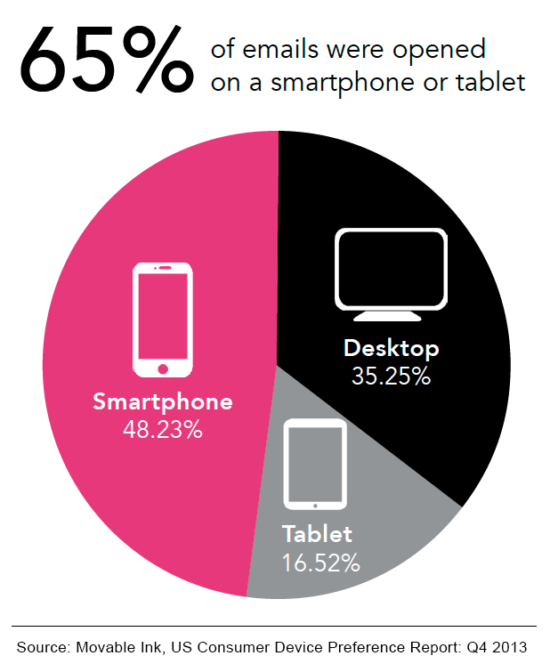
Mobile Devices in the Corporate World
Clint Hellyer
Ajay Singh

Slide 2
Agenda
Mobile devices role in the corporate world
BYOD
Company risks with mobile devices
MDMs and capabilities
How MDMs work
MDM examples
Concerns about BYOD and MDMs

Slide 3
Enterprise Mobile Tech Advancements
Mobile devices have become a common tool in both personal and work life
Companies have problems keeping personal devices out of the work place
90% of users report using at least one of their personal devices for work
Smaller, more portable = easier to lose or steal
Harder to secure and manage for an enterprise (less physical securities)

Slide 4
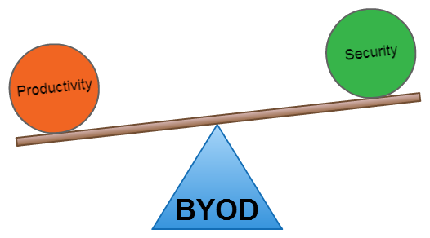
Bring Your Own Device
More commonly known as BYOD
Allows employees to use their personal device for company use
Employee using familiar device can increase productivity and convenience
No need for 2 devices
Not paying for device or full service (subsidized)

Slide 5
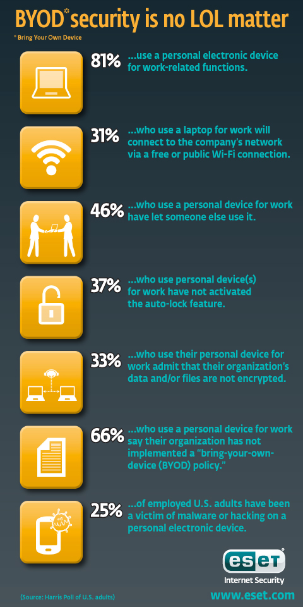
BYOD Employer Problems
Device Loss
  Company data and information can be compromised
Information Loss
  Unsecured wi-fi, lack of passwords, Bluetooth discoverable
Malicious Software
  Accidentally clicking malicious link or application
  Peer to peer file sharing – 3rd party observer

Slide 6
Mobile Device Management
MDM
  Deploying, securing, monitoring, integrating and managing mobile devices in the workplace
  Optimize the functionality and security of mobile devices while simultaneously protecting the network
EMM (Enterprise Mobility Management)
  MDM – manages the device
  MAM – manages applications
  MIM – manages information
MDM AND EMM ARE NOT SYNONYMS – they are technically different

Slide 7
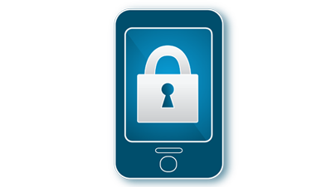

MDM Capabilities
Lock, disable, data wipe
Forcing Update
Monitor GPS location
Assignment of work roles (labels)
Whitelist/Blacklist applications
Wrapping Applications
Increased security
Data encryption (sentry)
Network Access Control
Reporting

Slide 8

Mobile Iron
One of many of the available MDMs out on the market
Main MDM used by Kindred Healthcare
Allows for multiple manageable cores or environments
Use of Sentry to encrypt sensitive information from enrolled devices
1:1 ratio for cores and sentry
Supports multiple device platforms

Slide 9
Sentry Overview
Inside Company
Outside Company
Sentry
Unencrypted data
Encrypted data
Company info going to unauthorized entity
Malicious Code

Slide 10
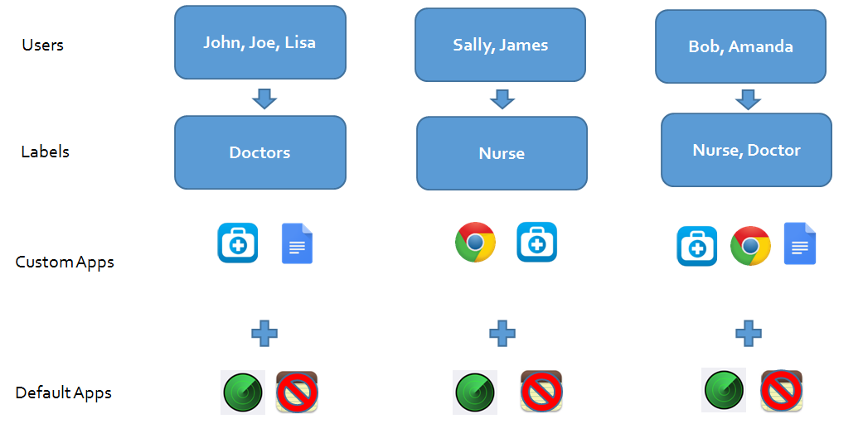

Slide 11
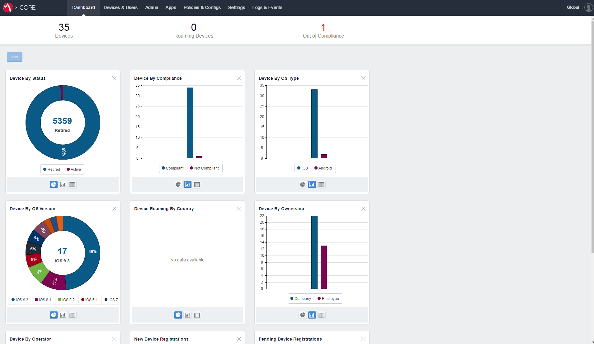

Slide 12
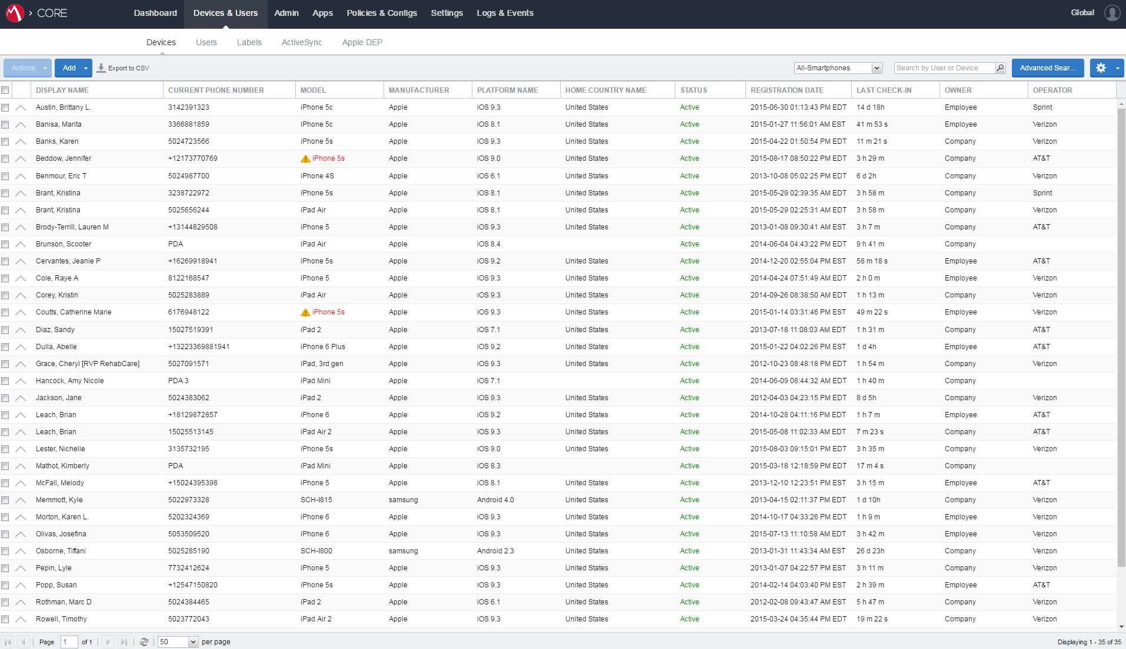

Slide 13
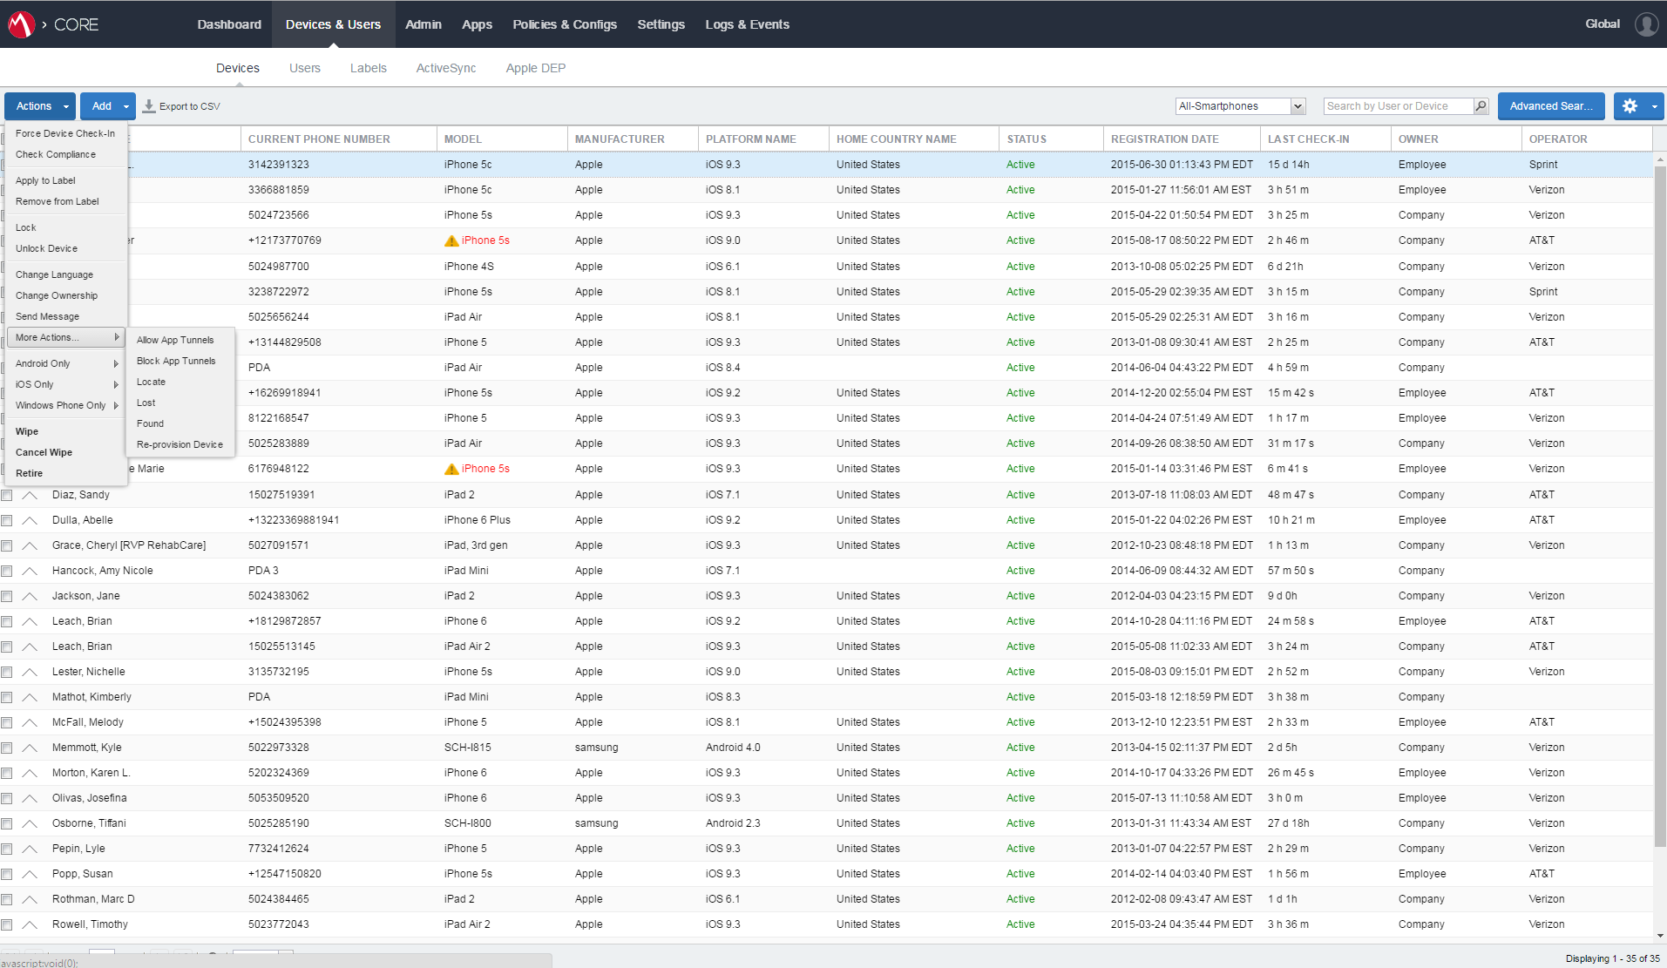

Slide 14
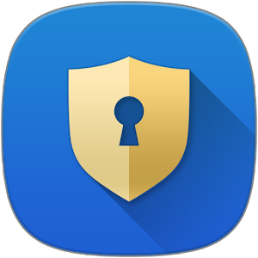
Samsung Knox
Application downloaded onto device
Works along side MDM’s
Allows for 2 separate environments or containers
https://www.youtube.com/watch?v=ywXoEoycSZI

Slide 15
Company Concerns/Solution
Security related concerns for the employer, solved with a MDM
Device loss
  Devices can be tracked and wiped
Information Loss
  Increased encryption through sentries and data wipes
Malicious Software
  Block apps and URLs
Must have connection to network to manage device
  Time-bomb

Slide 16
Employee Concerns/Solutions
Privacy related concerns for the employee
Users don’t know what personal information the employer has access too
  A well determined policy that is distributed and understood by all employees
Personal devices and information may be wiped
  Employee must understand this and take responsibility or else use their own device
Users may feel invasion of privacy
  Separate environments or profiles on a device - Samsung Knox

Slide 17
Conclusion
Must find a balance between security, privacy, and availability
Well stated and understood policy for BYOD
If a corporation wants to allow BYOD, MDM is the best solution right now
Employee’s aren’t forced to use their personal device, can use company device

Slide 18

Questions?

